Slide 1
CSE 465 Lecture 12 & 13
Sequence modelling with Neural Networks: RNN, LSTM and variants

Slide 2






What Problems are CNNs good at?
Image/Video classification
Input – image
Output – probability distribution of classes
The algorithm take an image – extract features – provide a guess

Slide 3







What is Sequence Learning?
Sequence learning is the study of machine learning algorithms designed for sequential data
Language model is one of the most interesting topics that use sequence labeling
Language translation
Translate from English to Bengali/ Bengali to English
Stock value prediction
Speech recognition
Sentiment analysis
Music generation
Time series analysis
Etc.

Slide 4
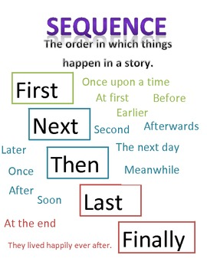

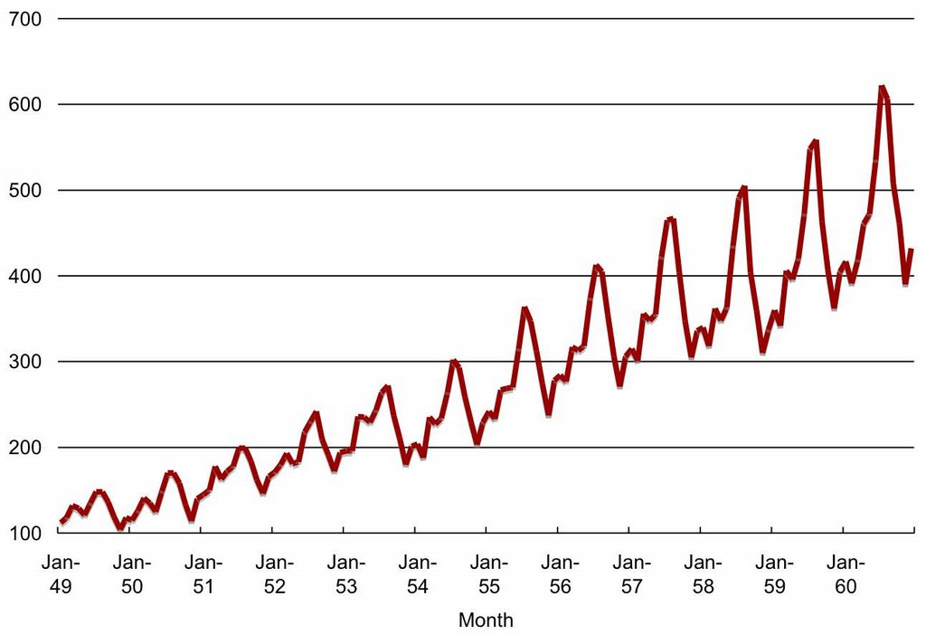

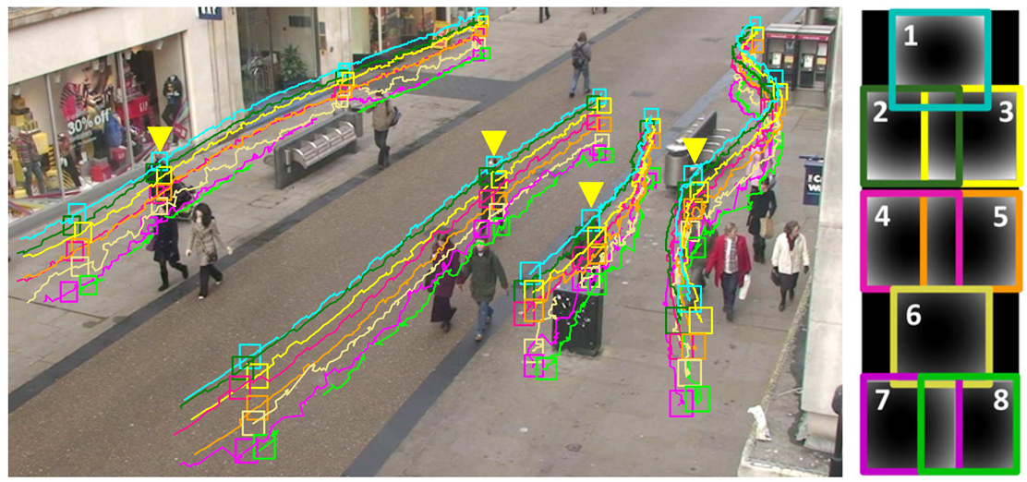

Sequence learning problems

Slide 5















OK - But what’s wrong with CNN?
Plain CNNs are not good at length-varying input and output
Difficult to define input and output
Normally input is a 3D matrix (Length, Width, Color channels)
Output is a probability distribution on fixed number of classes
Sequence on the other hand
Have varying-length input
Varying-length output
Input-output are strongly correlated within sequence
Still there are attempts to use CNN for sequence learning

Slide 6
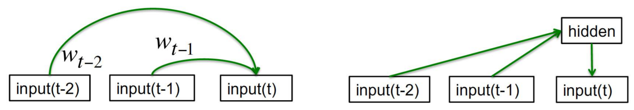






How to learn sequences?
Autoregressive models
Predict the next term in a sequence from a fixed number of previous terms
Feed-forward neural nets
These generalize autoregressive models by using one or more layers of non-linear hidden units
Memoryless models: limited word-memory window; hidden state cannot be used efficiently

Slide 7
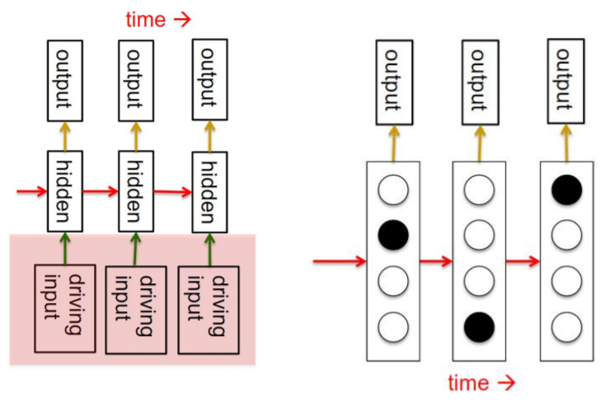





How to learn sequences?
Linear Dynamic Systems
These are generative models
They have a real-valued hidden state that cannot be observed directly
Hidden Markov Model
Have a discrete one-of-N hidden state
Transition between states are stochastic and controlled by a transition matrix
The outputs produced by a state are stochastic
With-memory models

Slide 8
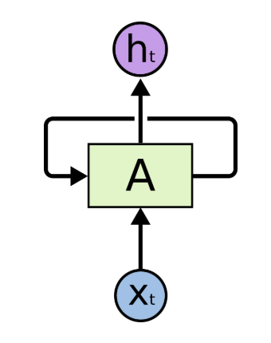

How to learn sequences?
And RNN
Update the hidden state in a deterministic nonlinear way
In the simple speaking case, we send the chosen word back to the network as input

Slide 9
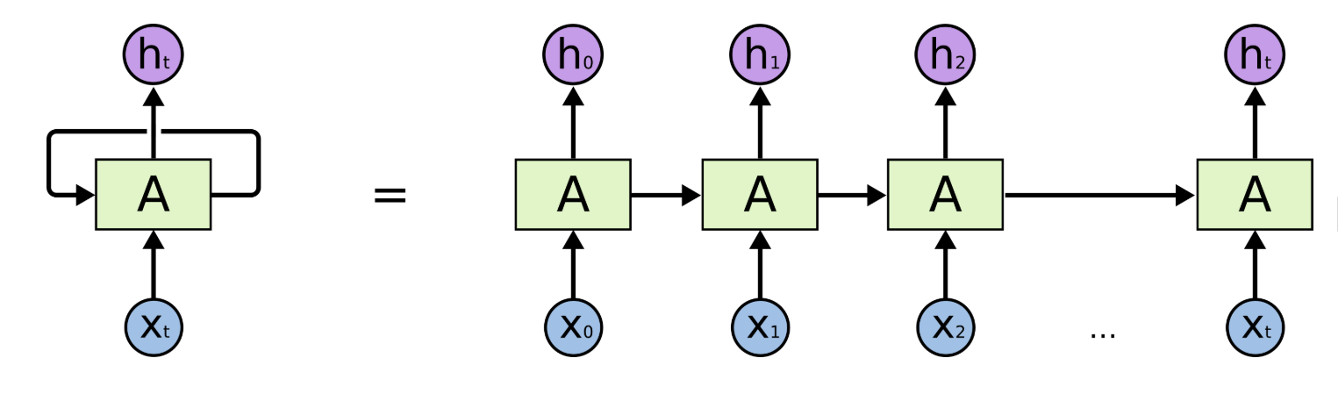








How does it look?

Slide 10
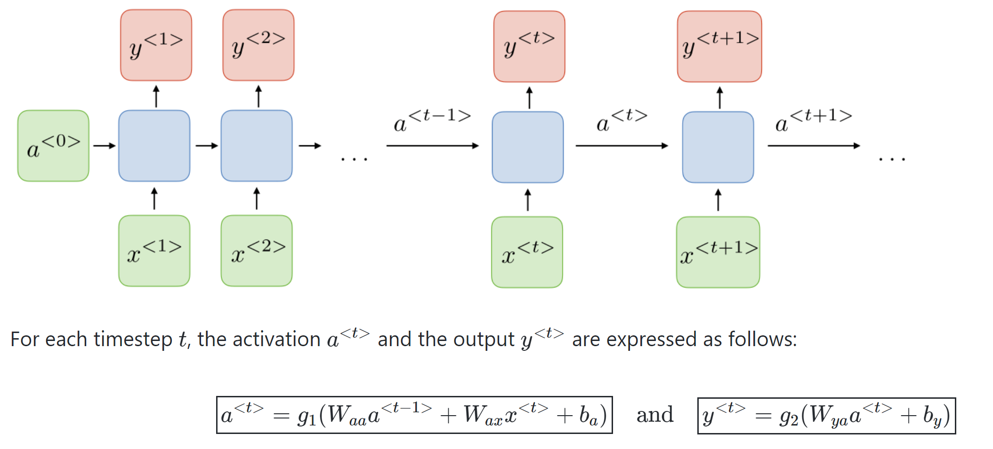












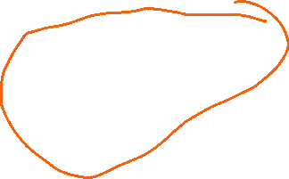









With a little more details

Slide 11
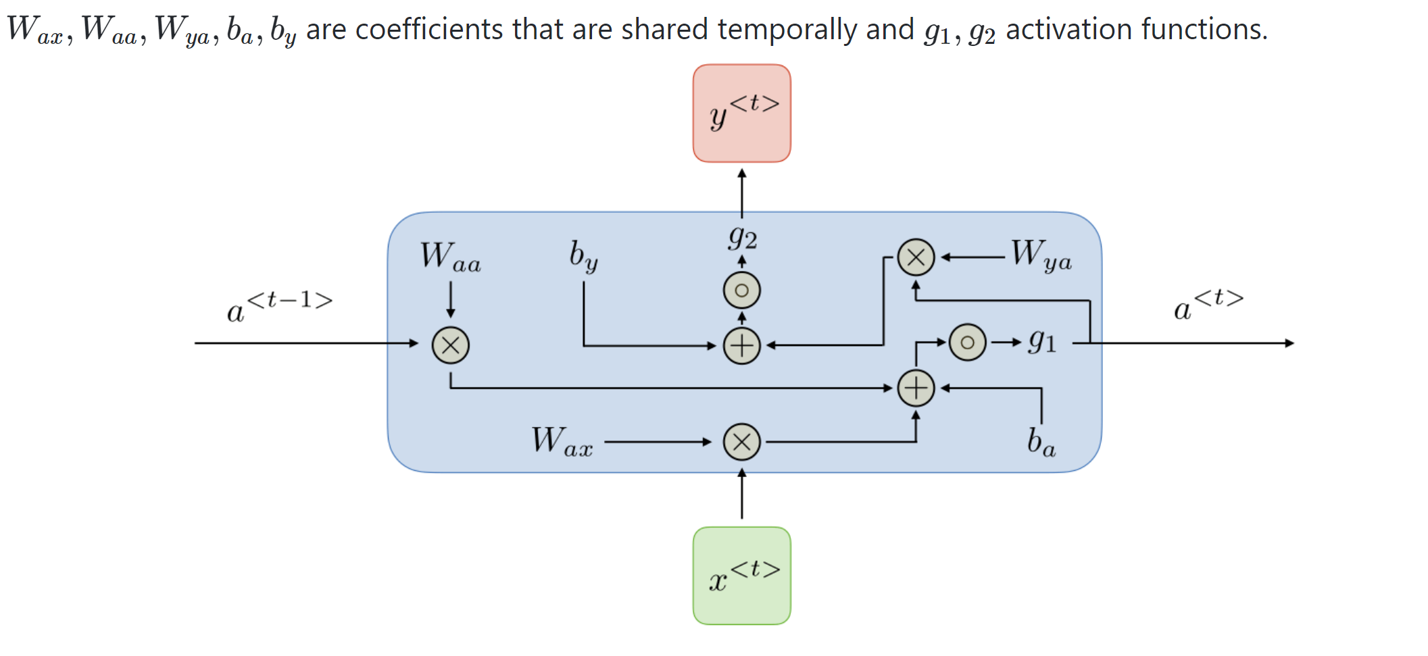















Detailed view of an RNN unit

Slide 12
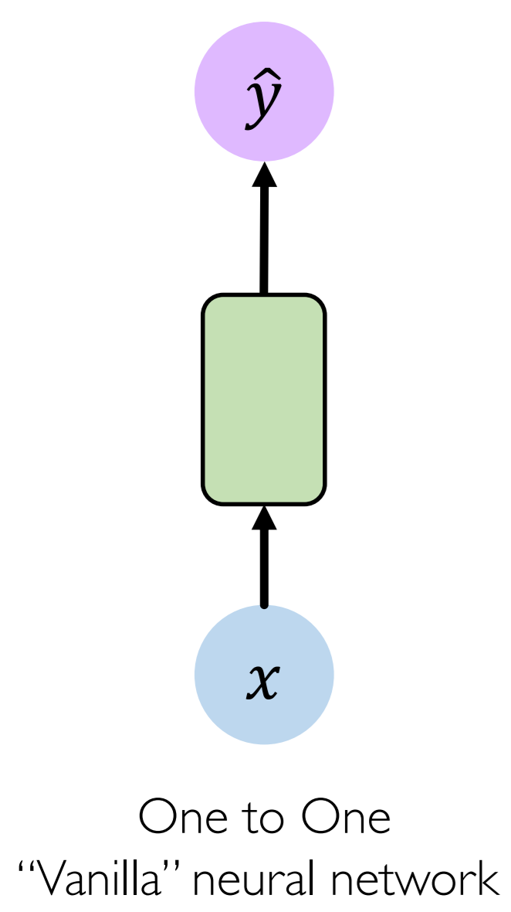
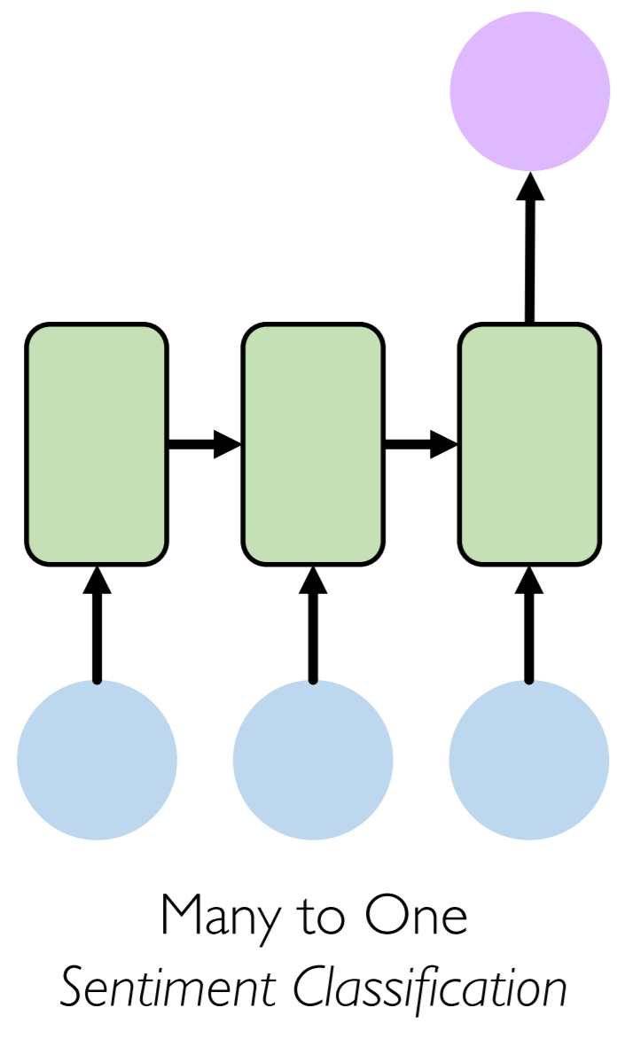
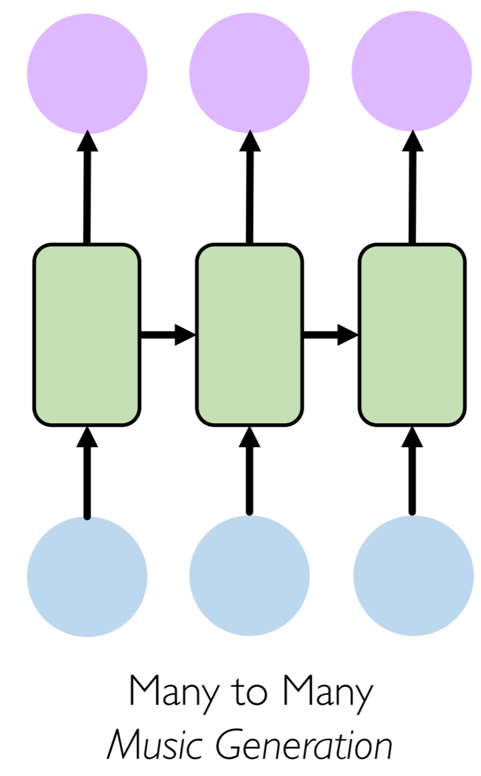










Types of RNN

Slide 13
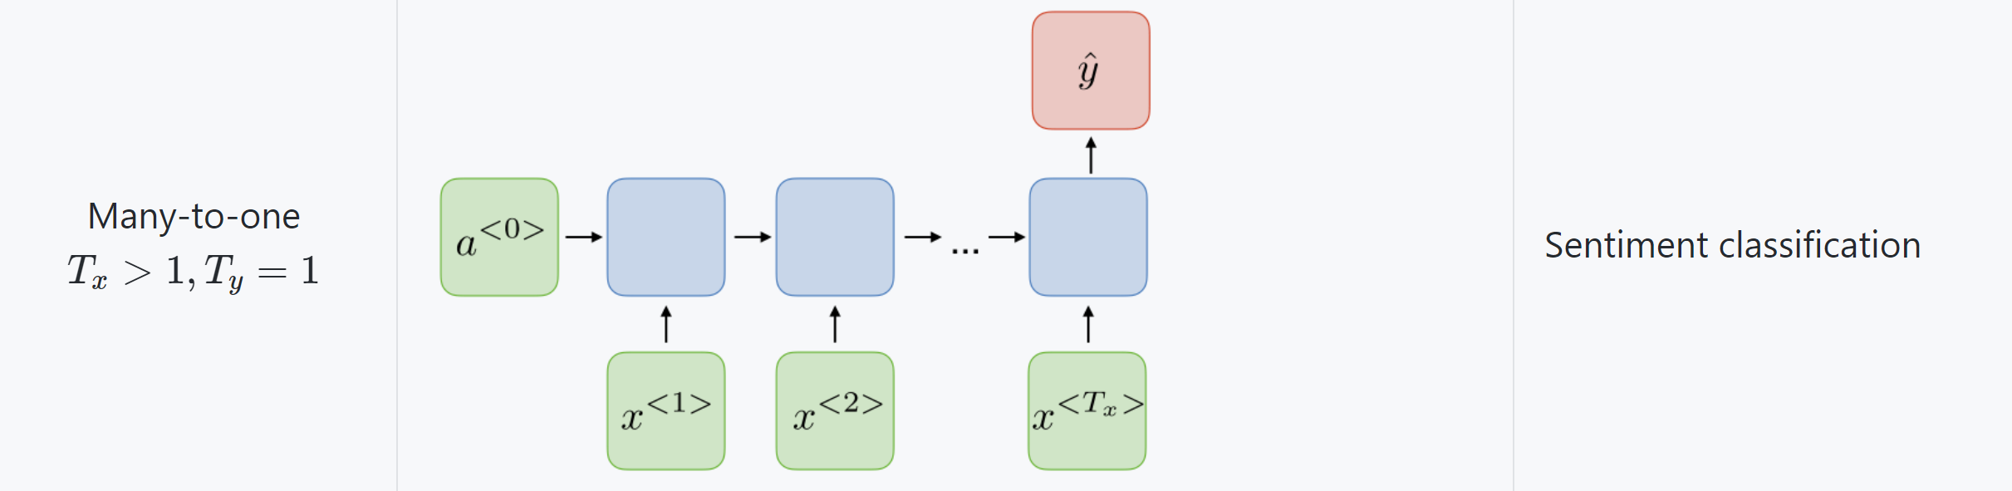
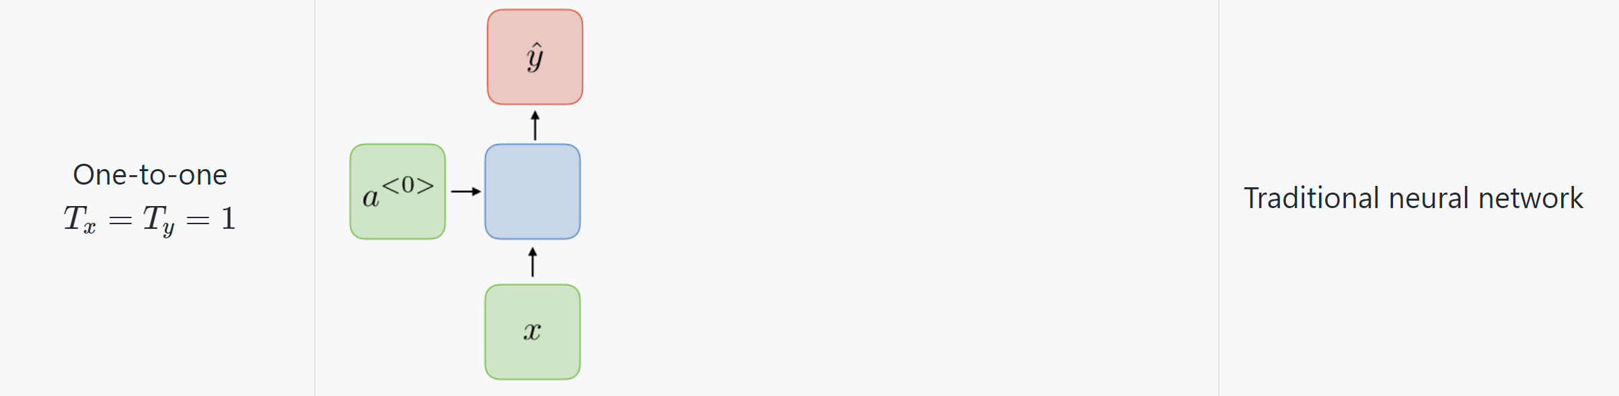
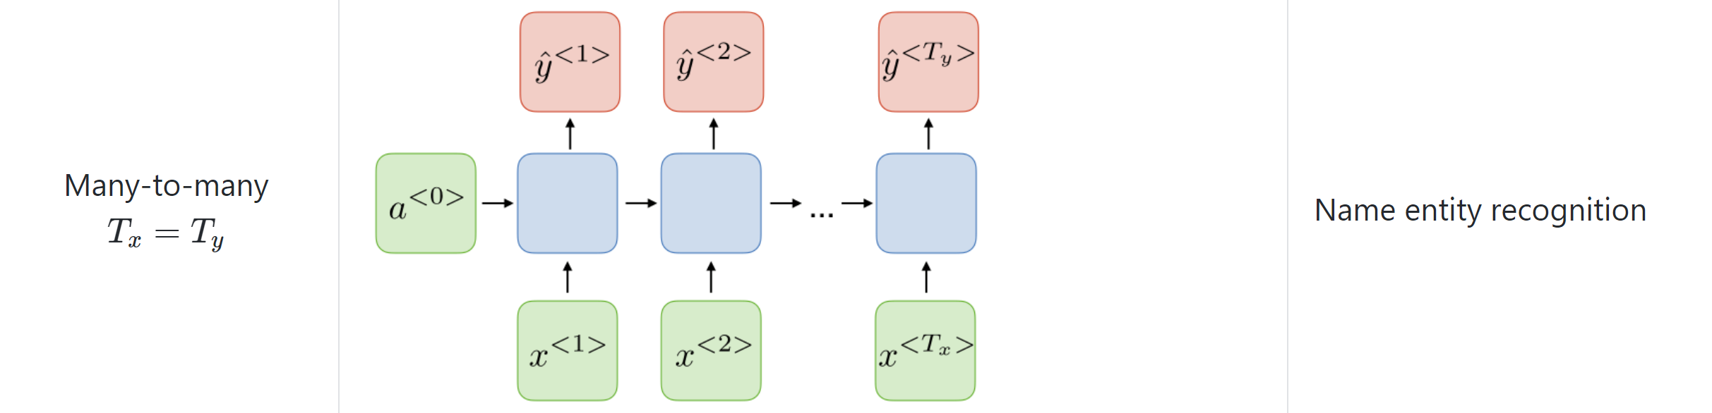
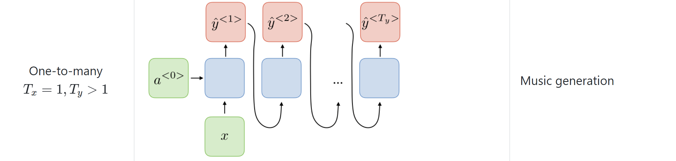








RNN Architecture for different applications

Slide 14











Sequence learning problem
English language modelling
Use one hot representation
We need a dictionary
Unknown words make problems
We can limit the sequence when
A sentence ends (with a dot)
For an entire paragraph
For entire story (huge network to train)
Or we can use characters
We need the models for speech recognition/OCR/almost all sorts of text processing

Slide 15
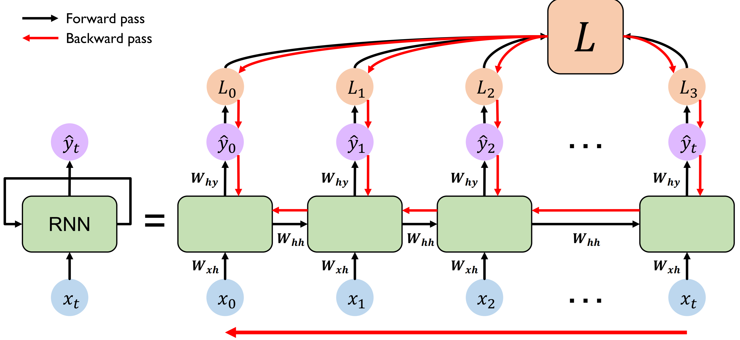





























Backpropagation through time

Slide 16
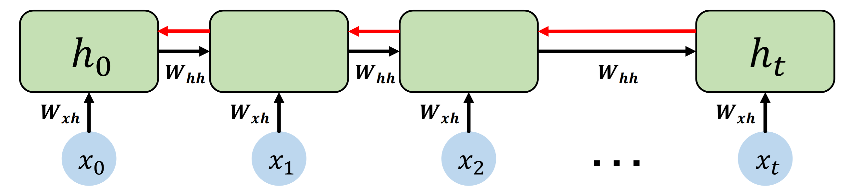




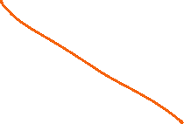

Gradient flow in RNN
Computing the gradient wrt ℎ involves many factors of W_{hh} (and repeated g′)
Many values > 1
Exploding gradient
Clip the values
Many values < 1
Vanishing gradient
Hard problem – use different type of network

Slide 17
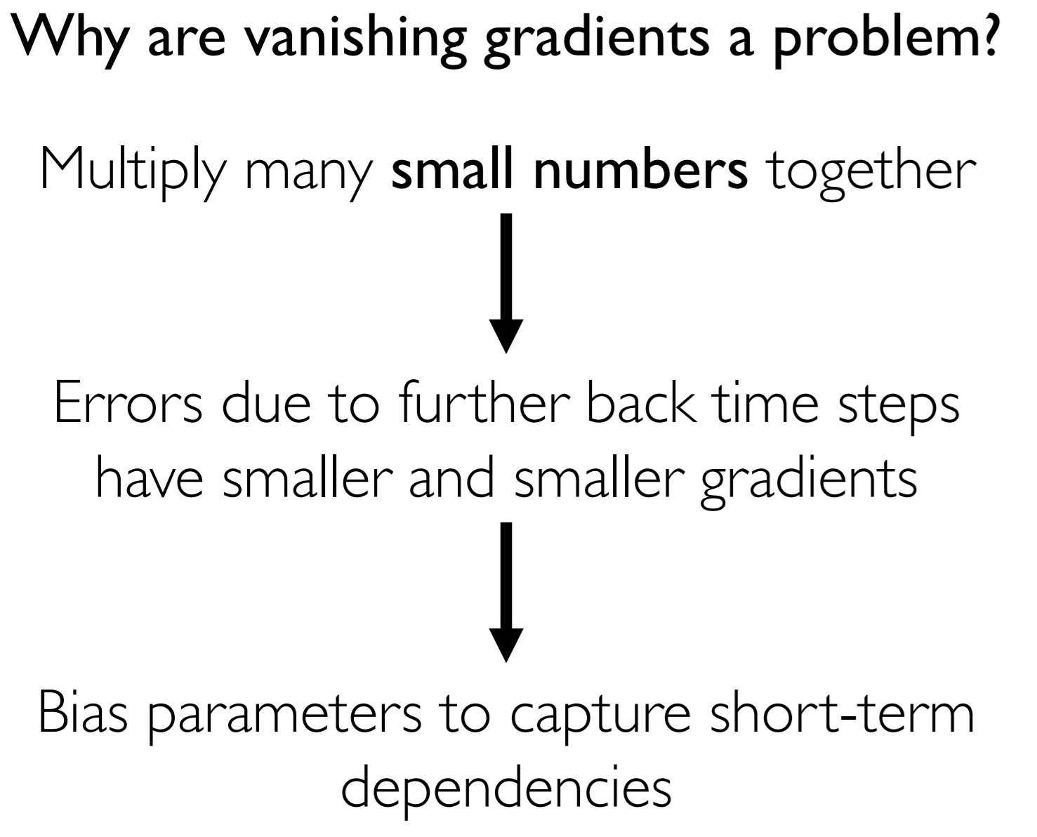
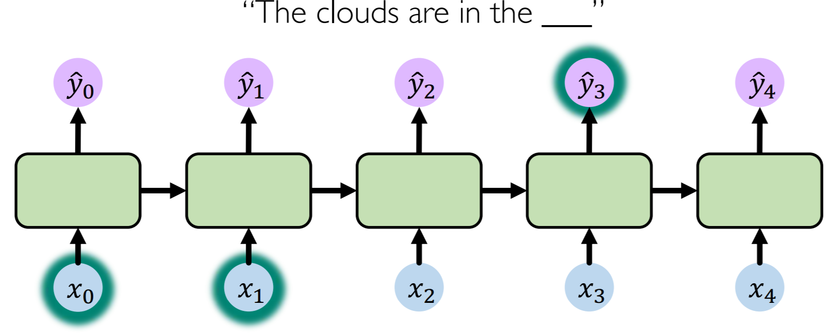
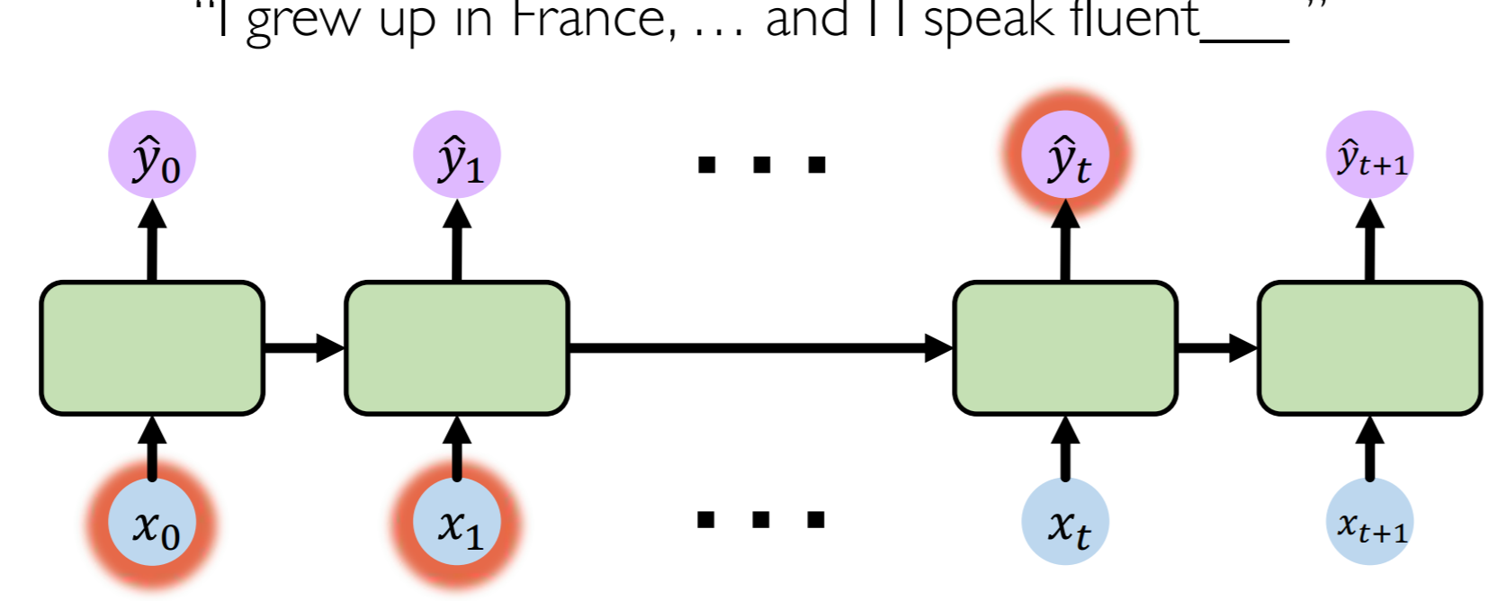








Problem of long-term dependency

Slide 18
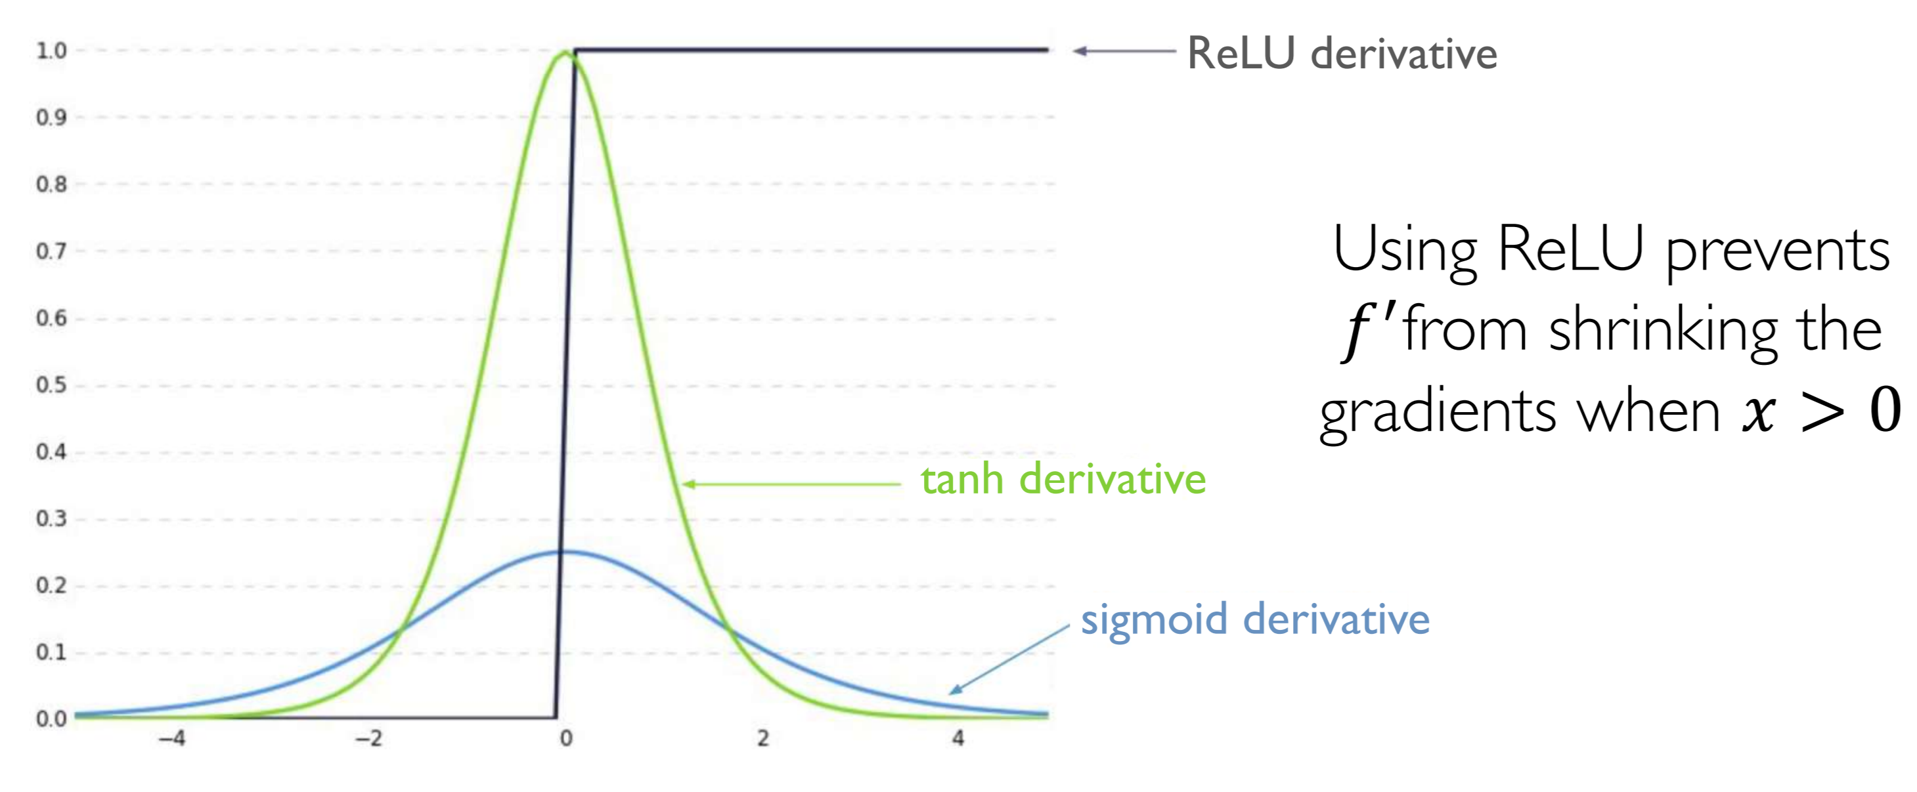







Partial solution 1

Slide 19
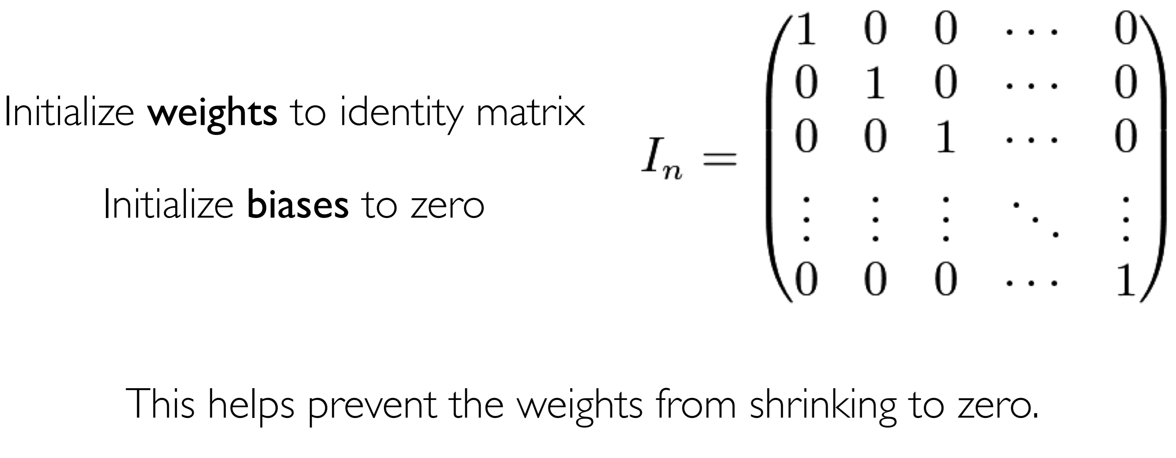







Partial solution 2

Slide 20










































Slide 21
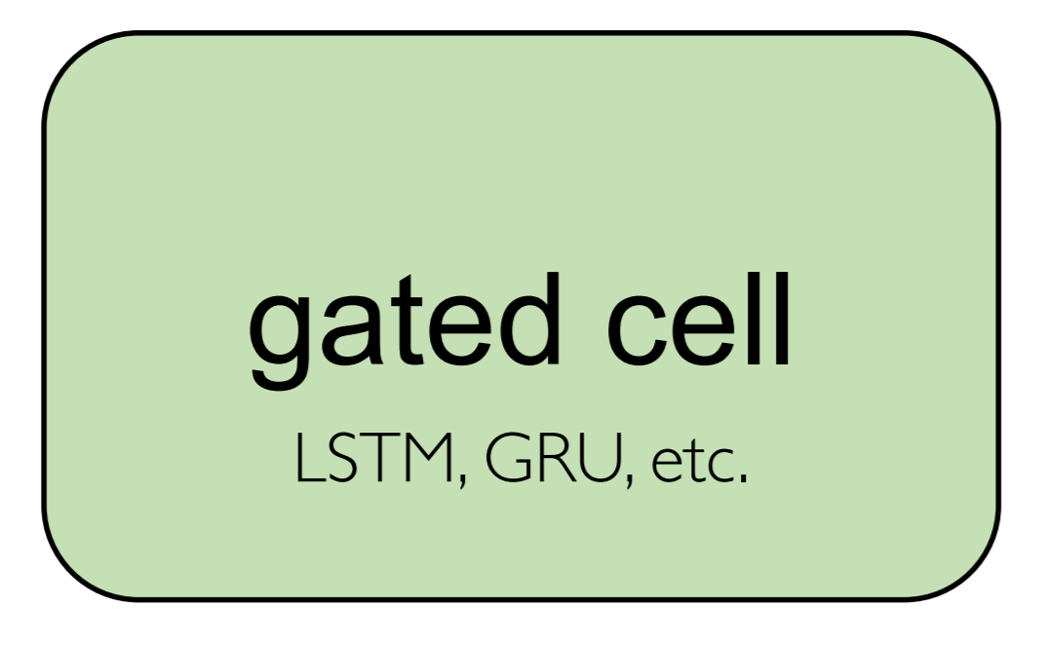



Main Solution – Different kind of units
Use a more complex recurrent unit with gates to control what information is passed through
Long Short Term Memory (LSTMs) networks rely on a gated cell to track information throughout many time steps

Slide 22
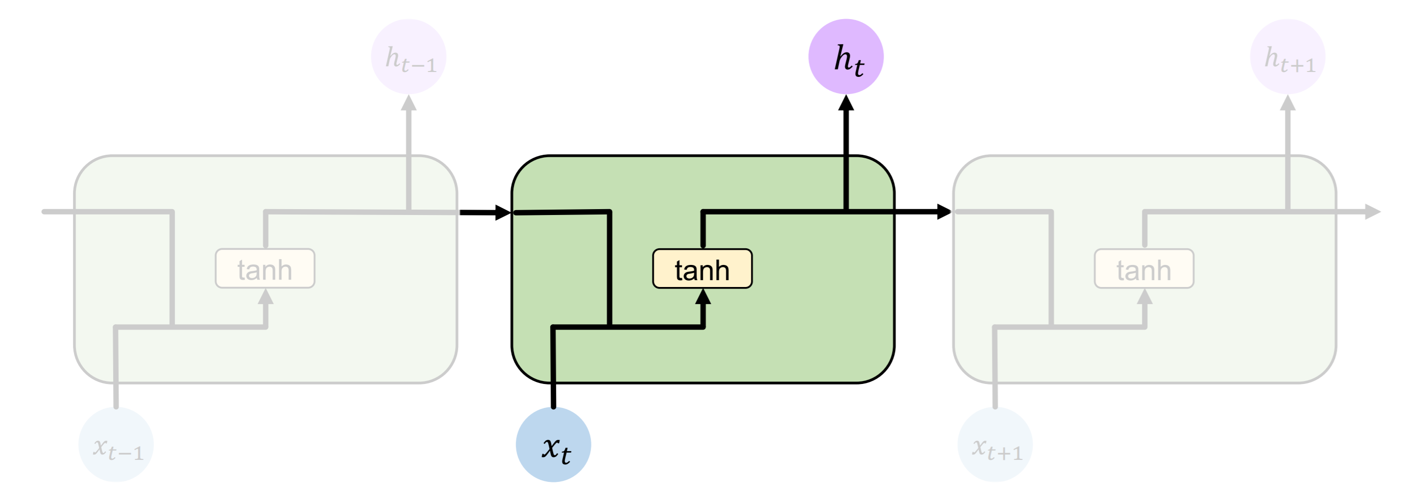
Standard RNN
In standard RNN repeating modules contain a simple computation unit

Slide 23
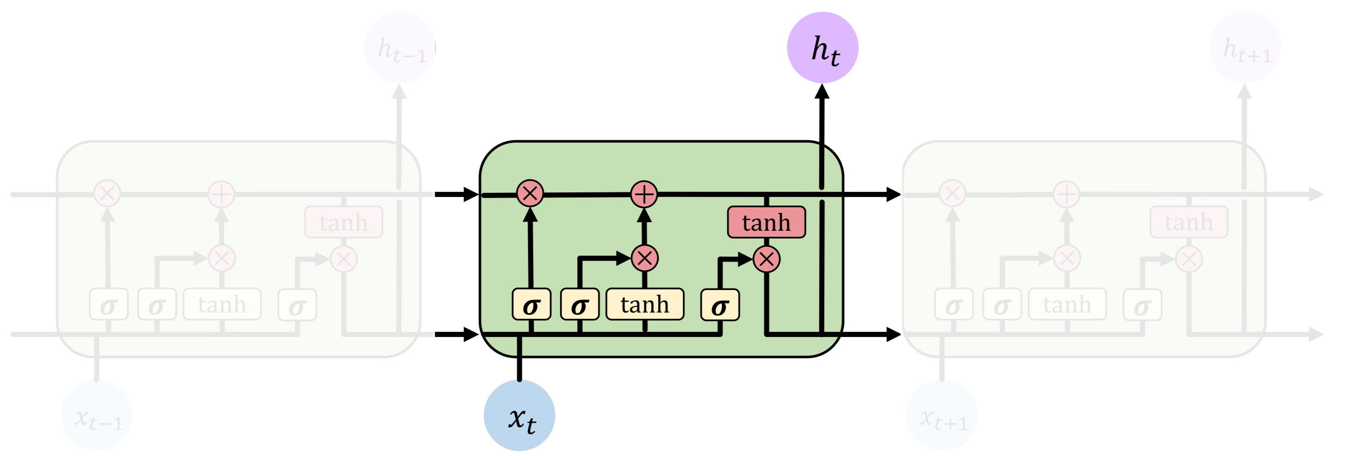


LSTM
LSTM repeating modules contain interacting layers that control information flow
LSTM cells can track information throughout many timesteps

Slide 24
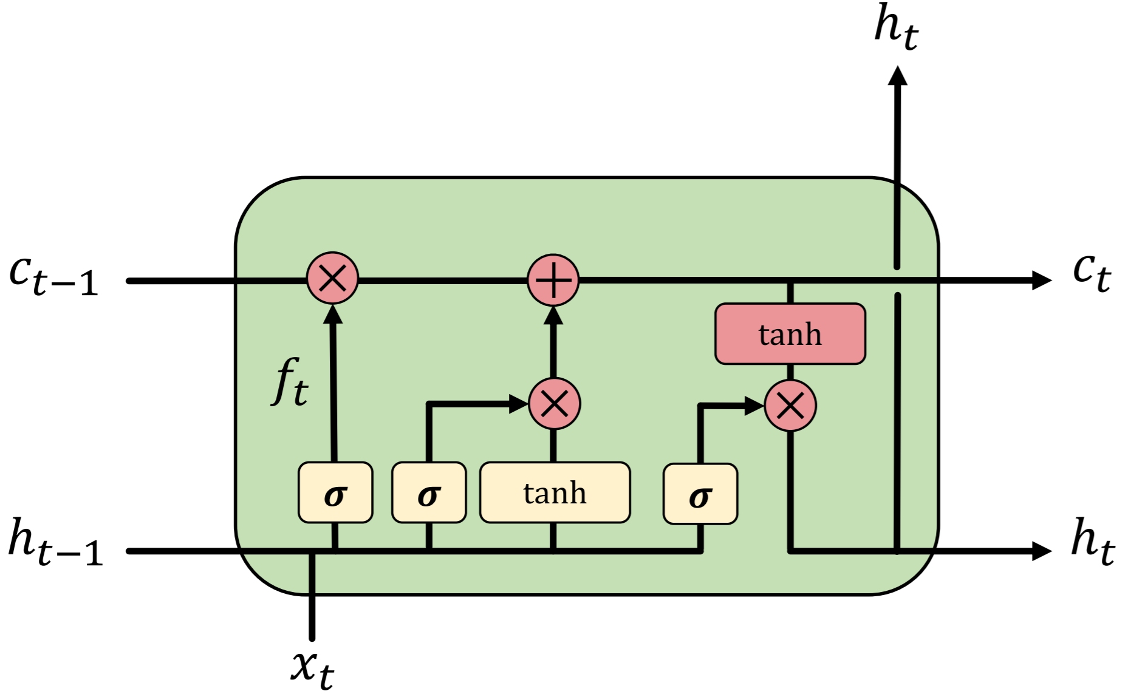
A complete LSTM unit

Slide 25
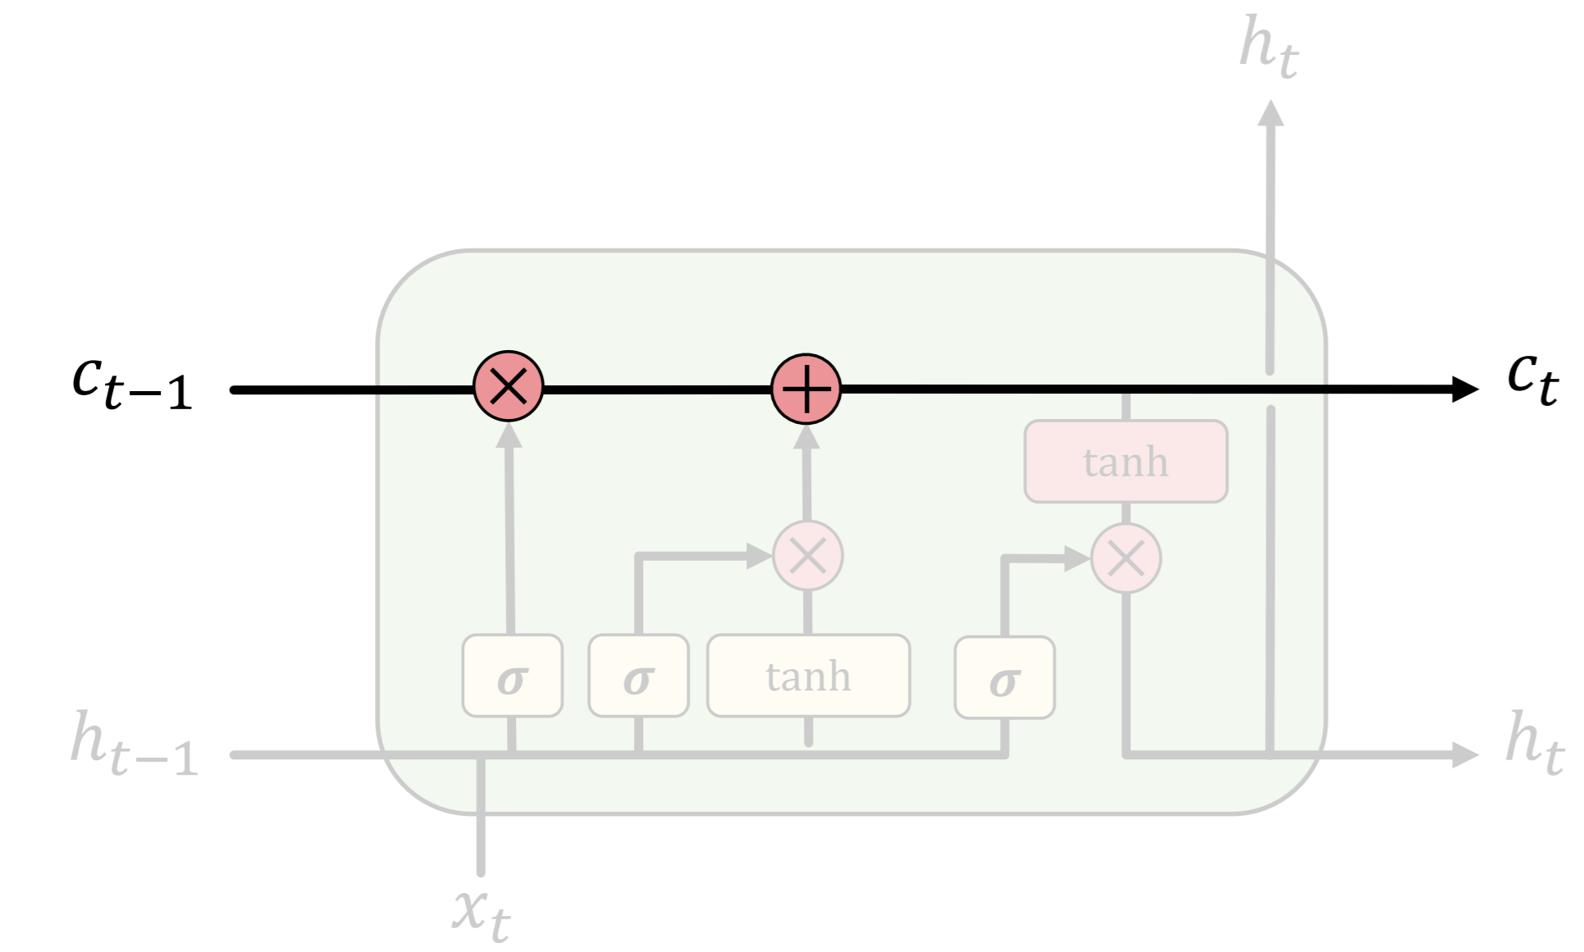
















LSTM
LSTMs maintain a cell state C_{t} where it’s easy for information to flow

Slide 26
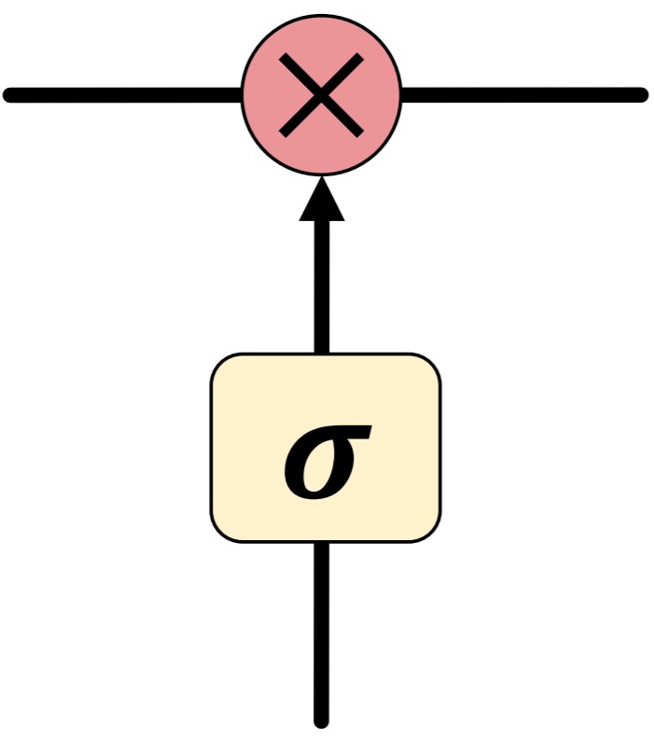
LSTM
Information is added or removed to cell state through structures called gates
Gates optionally let information through, via a sigmoid neural net layer and pointwise multiplication

Slide 27
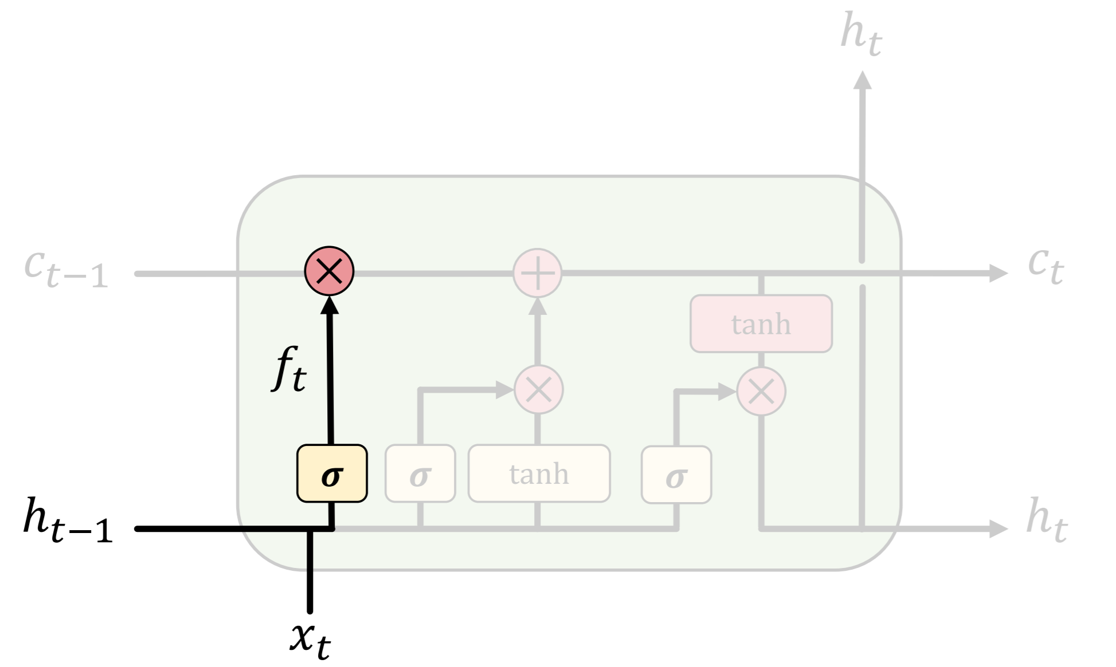




















LSTMs forget irrelevant parts of the previous state: When we see a new subject we forget the old subject to pick the correct pronouns.

Slide 28
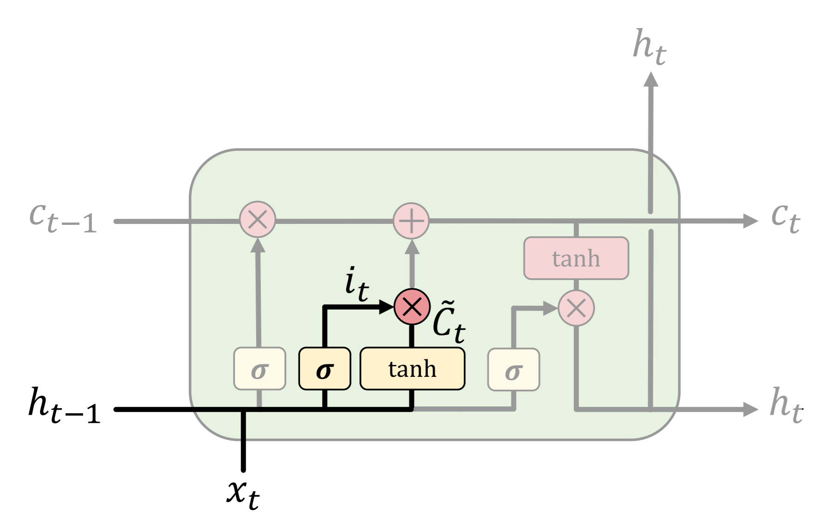














LSTMs selectively update cell state values: maybe we want to add gender of the new subject

Slide 29
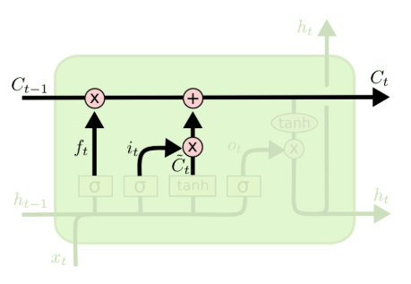










Update Ct: drop the information about the old subject’s gender and add the new information

Slide 30
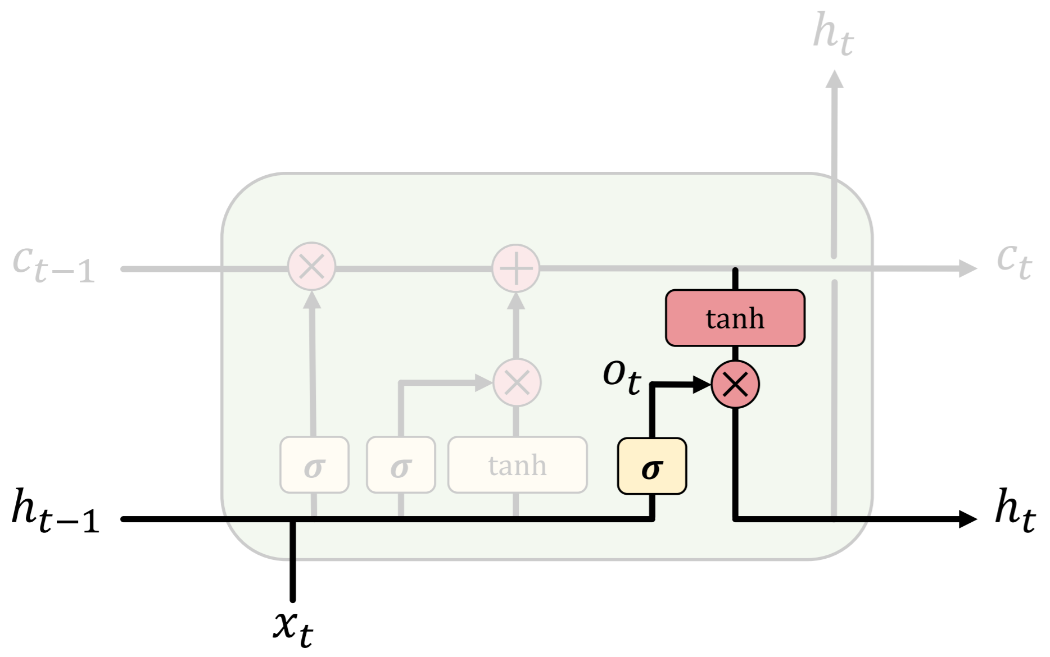



























LSTMs use an output gate to output certain parts of the cell state: it might output whether the subject is singular or plural, so that we know what form a verb should be

Slide 31
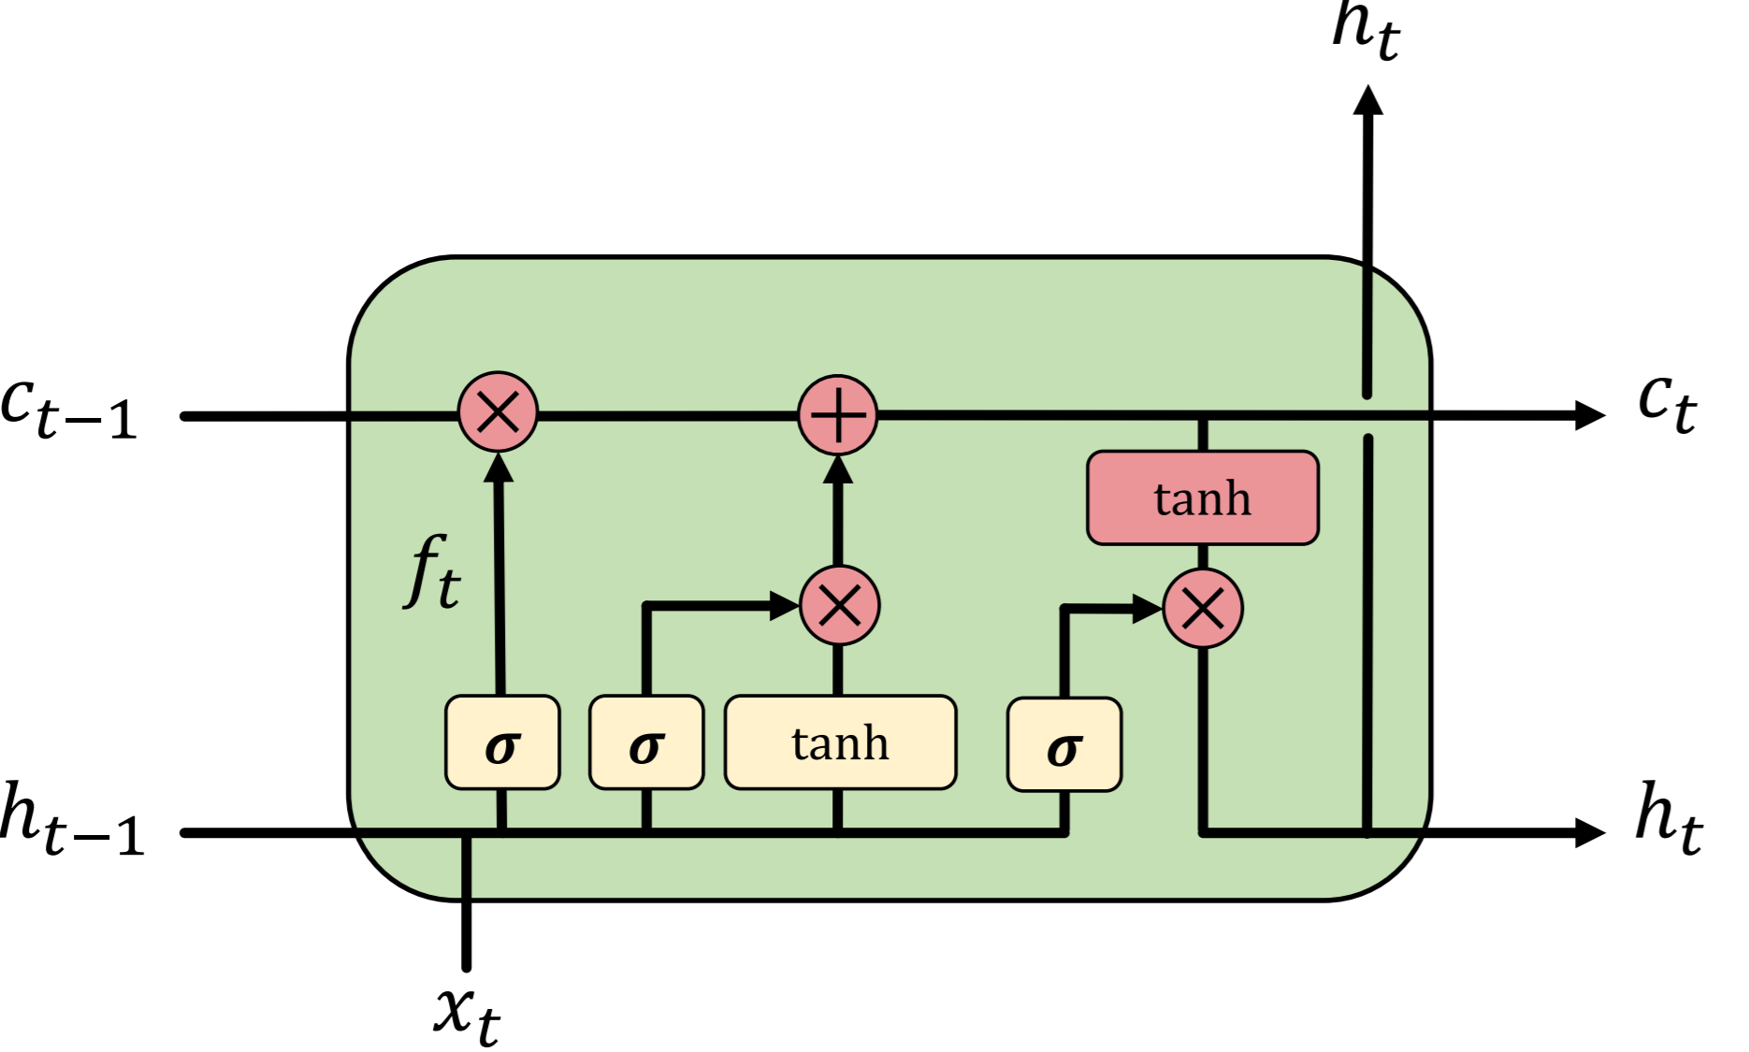
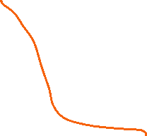



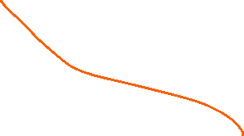


How do LSTMs work?
1) Forget 2) Update 3) Output

Slide 32
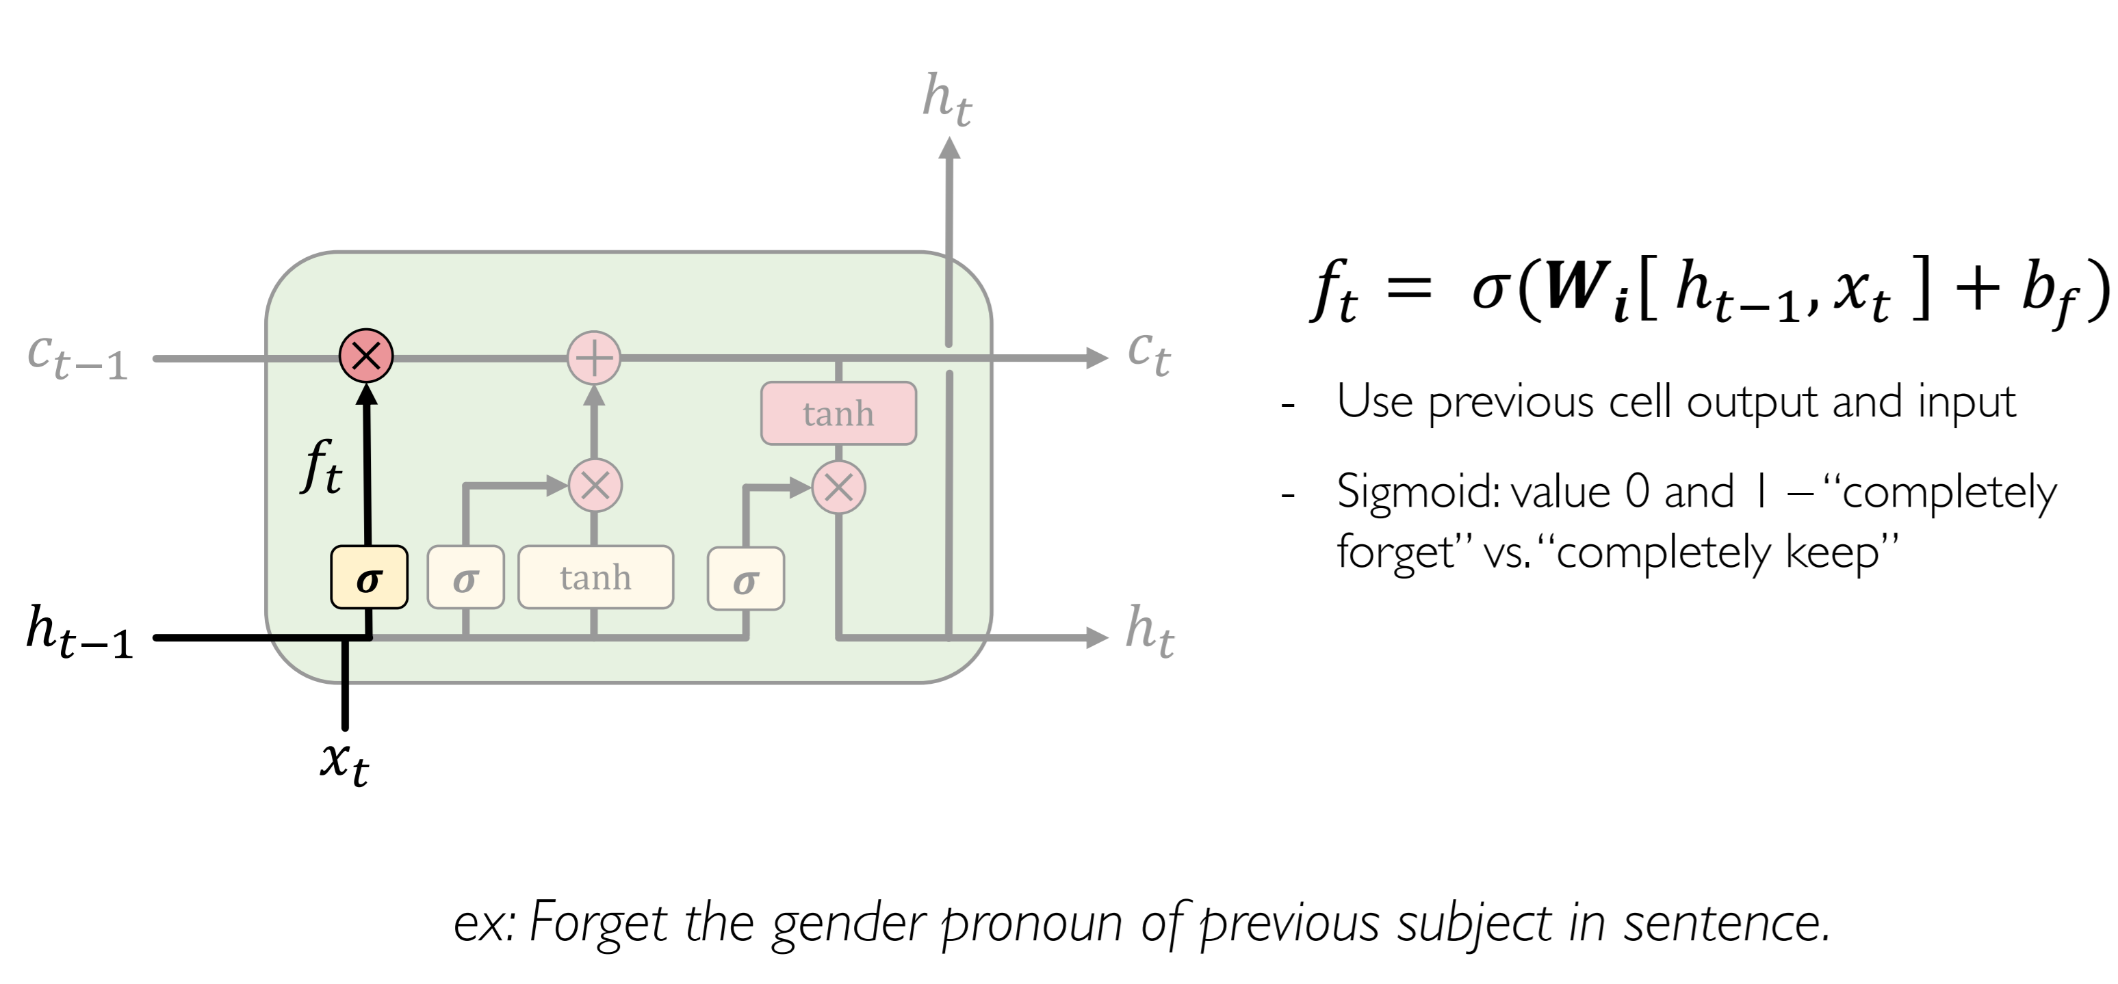













LSTM: Forget irrelevant information

Slide 33
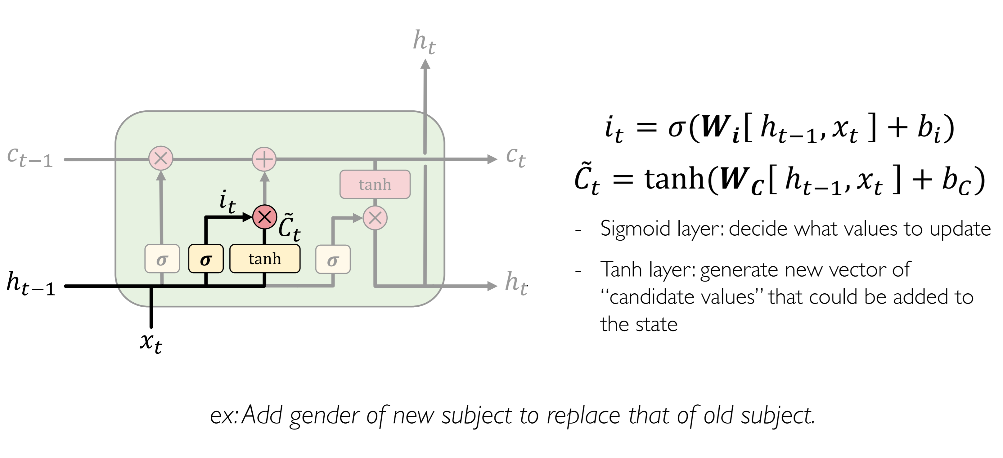









LSTM: Identify new information to store

Slide 34
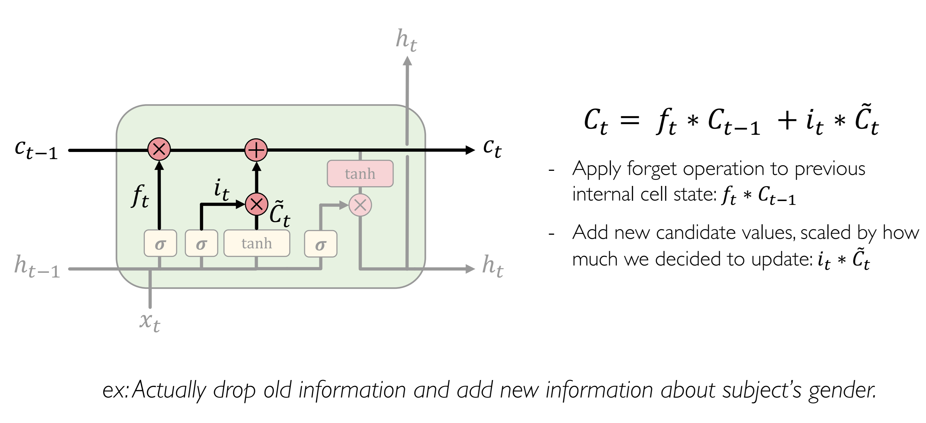











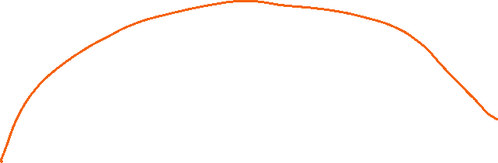
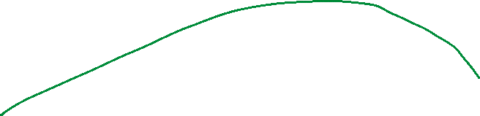
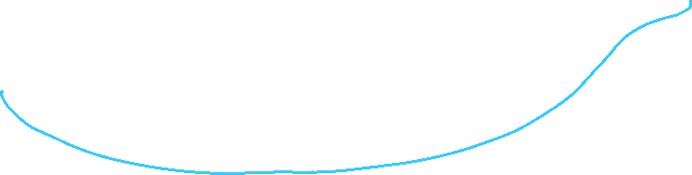
LSTM: Update new state

Slide 35
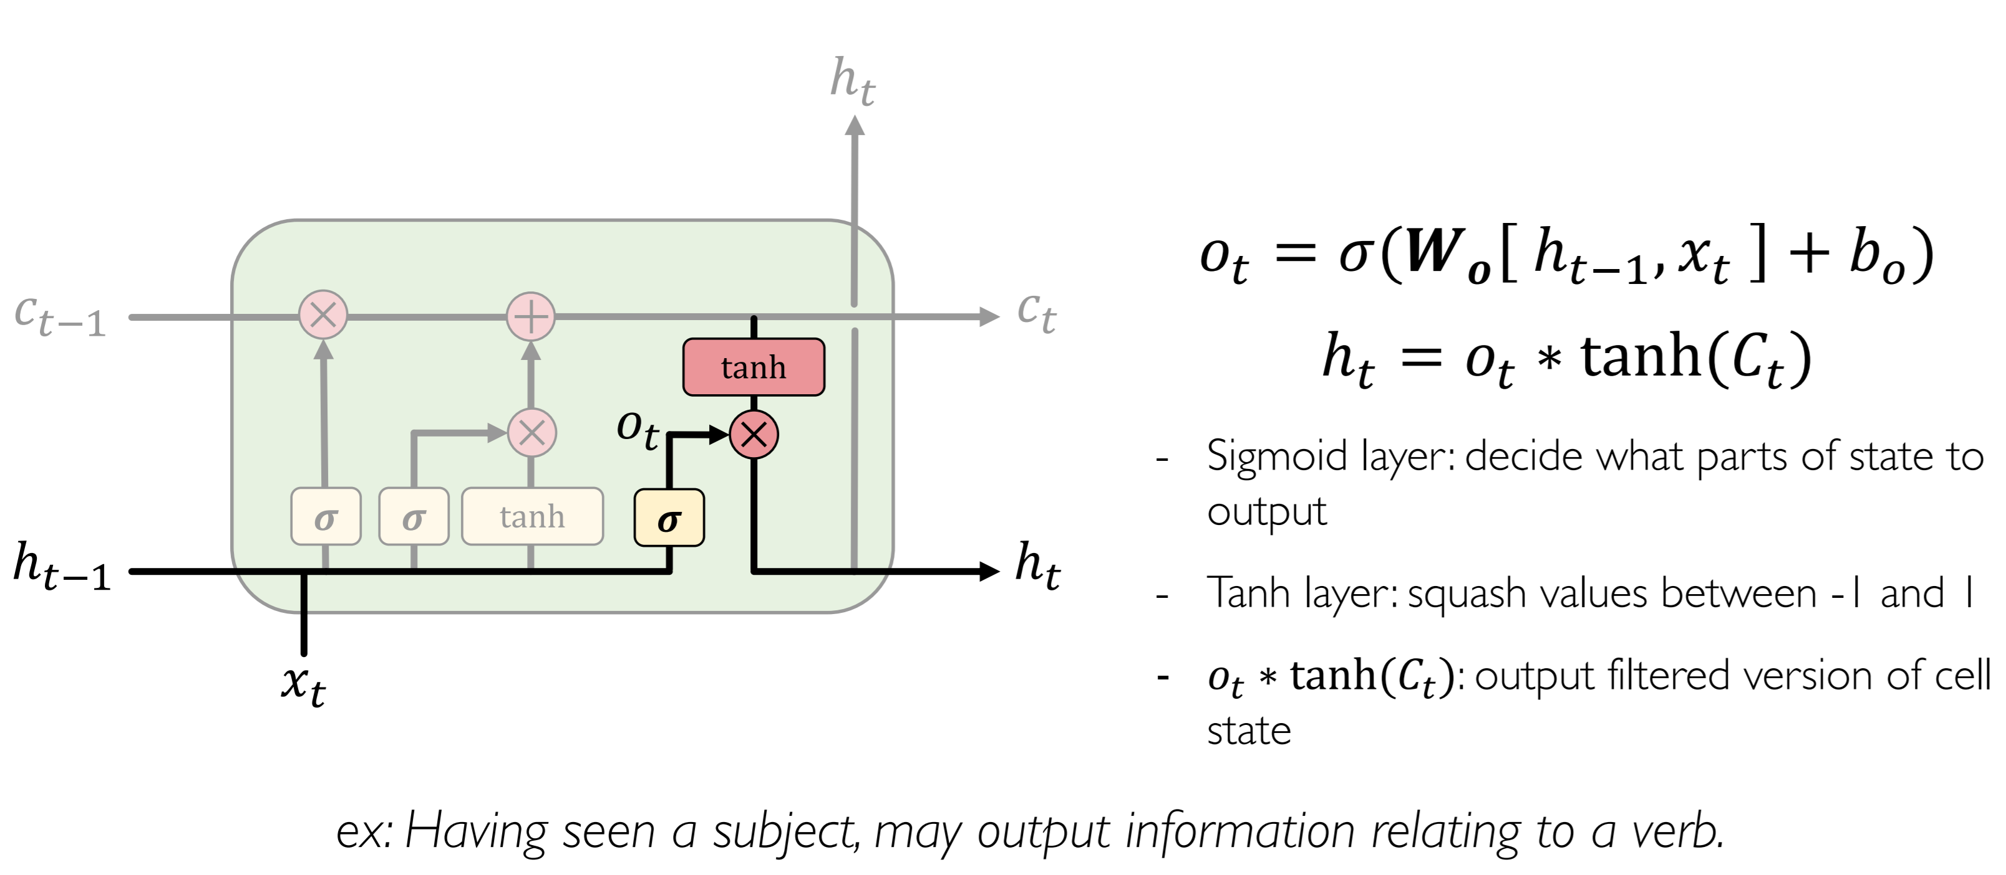









LSTM: output modified by the memory

Slide 36
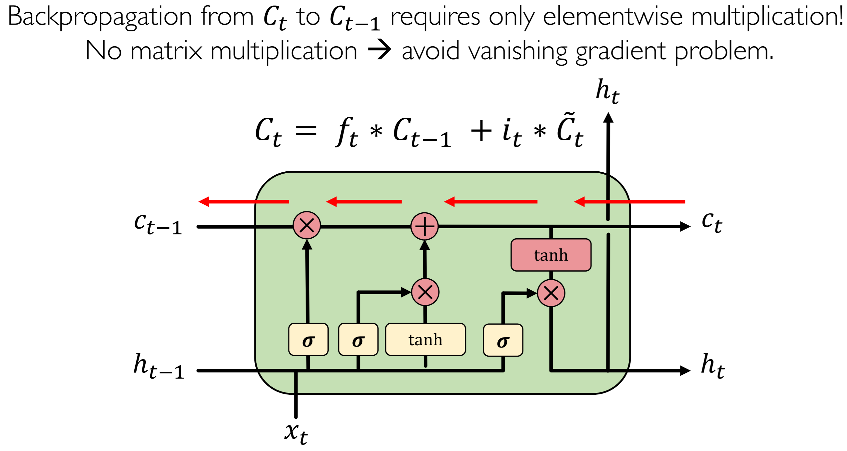




LSTM gradient flow

Slide 37
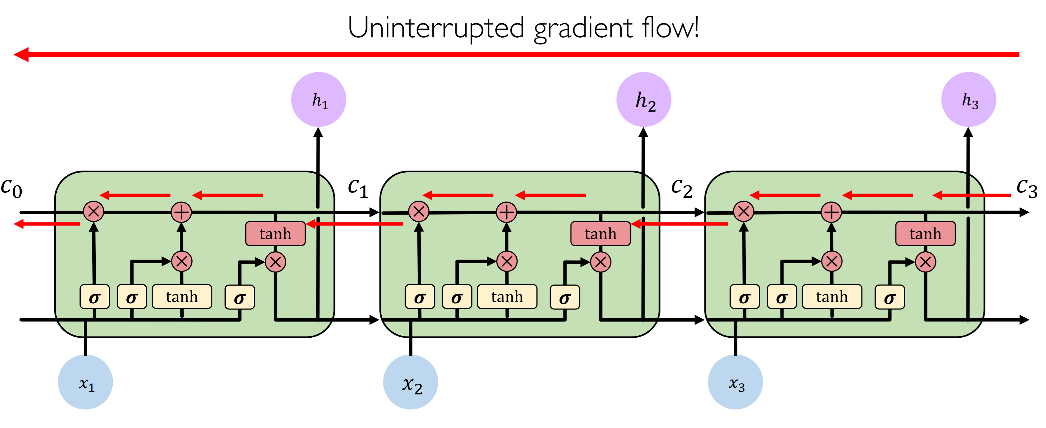











LSTM gradient flow

Slide 38
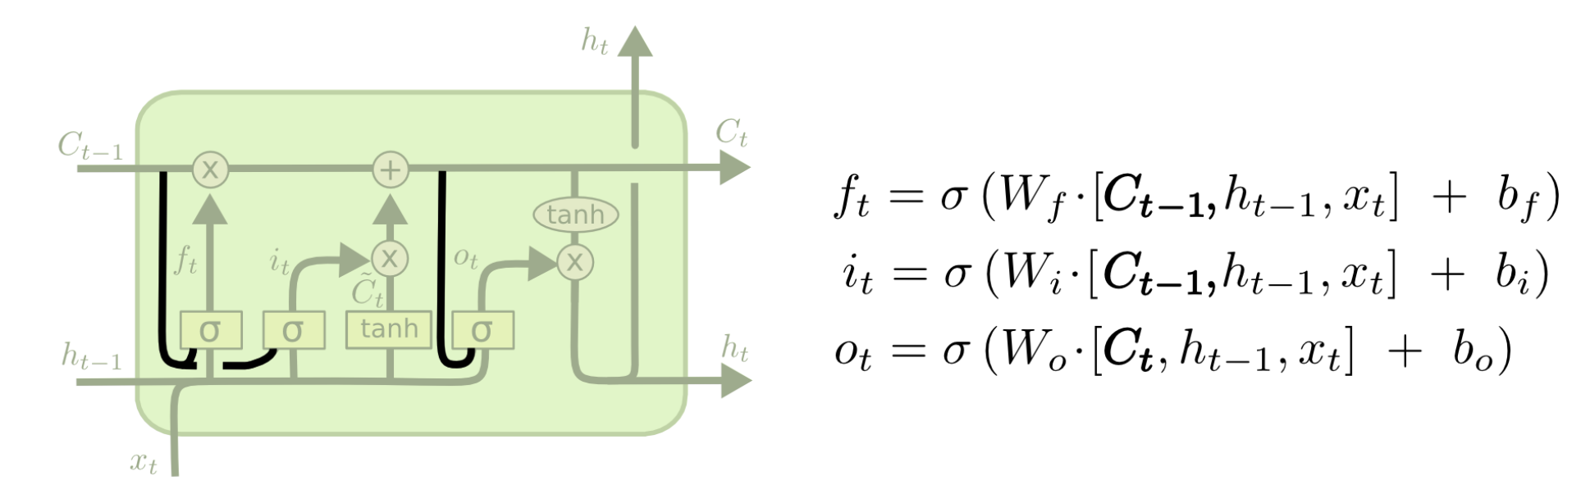
LSTM variant 1: Peephole connection

Slide 39
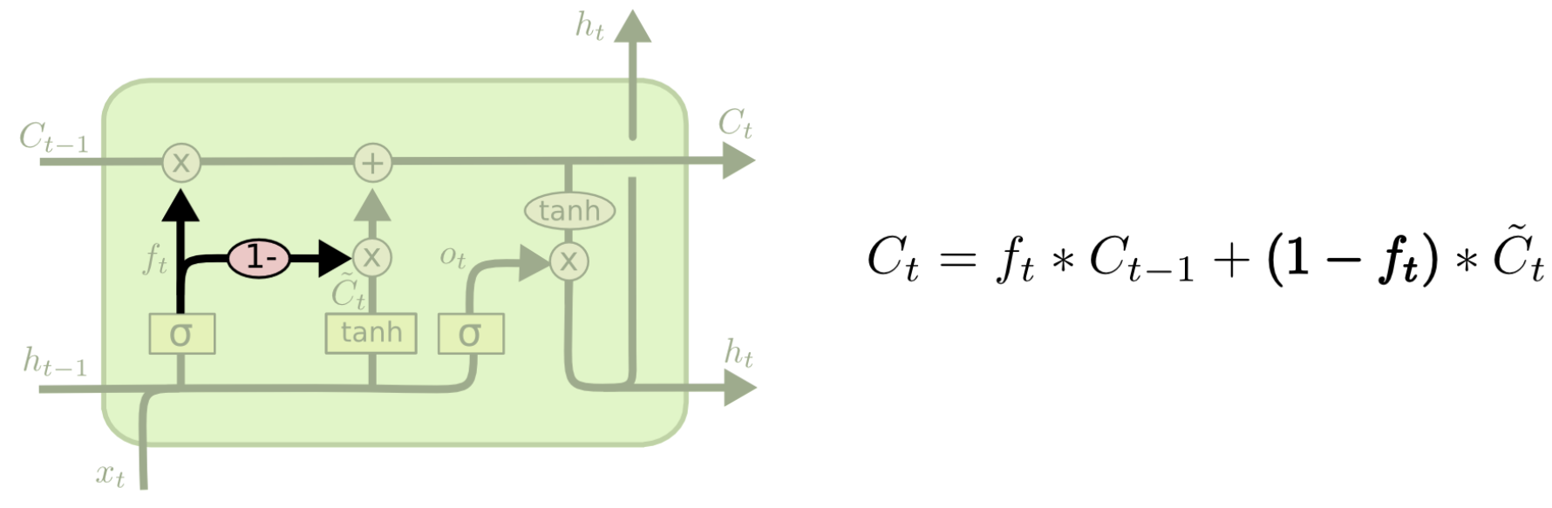


LSTM variant 2: couple forget and input

Slide 40
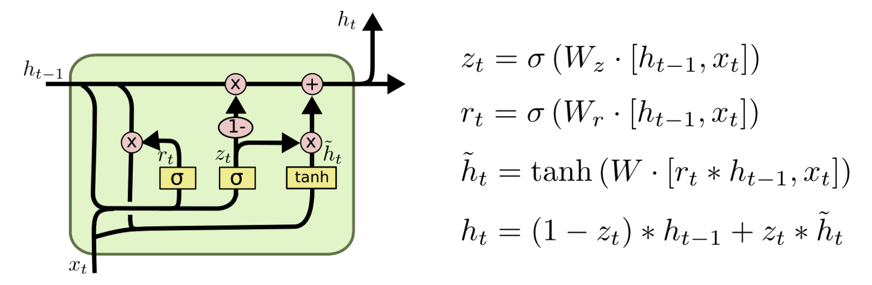
LSTM variant 3: GRU
Combines the forget and input gates into a single “update gate”
Merges the cell state and hidden state
The resulting model is simpler than standard LSTM models, and has been growing increasingly popular

Slide 41













Slide 42



















Slide 44
LSTM: Summary
Maintain a separate cell state from what is outputted
Use gates to control the flow of information
Forget gate gets rid of irrelevant information
Selectively update cell state
Output gate returns a filtered version of the cell state
Backpropagation from C_{t} to C_{t-1} does not require matrix multiplication
Uninterrupted gradient flow

